Slide 1
Test Plan
Team Argus

Slide 2
Overview
Introduction
Architectural Design
Detailed Design
Test Items
Risk Assessments
Features to be Tested
Features not to be Tested
Testing Approach
Pass/Fail Criteria
Test Deliverable
Test Schedule

Slide 3
Introduction
What we’re working on
Devices to be tested
Nexus 7
Lynx
Samsung SUR40
Customer Requirements will be covered in Features to be Tested

Slide 4
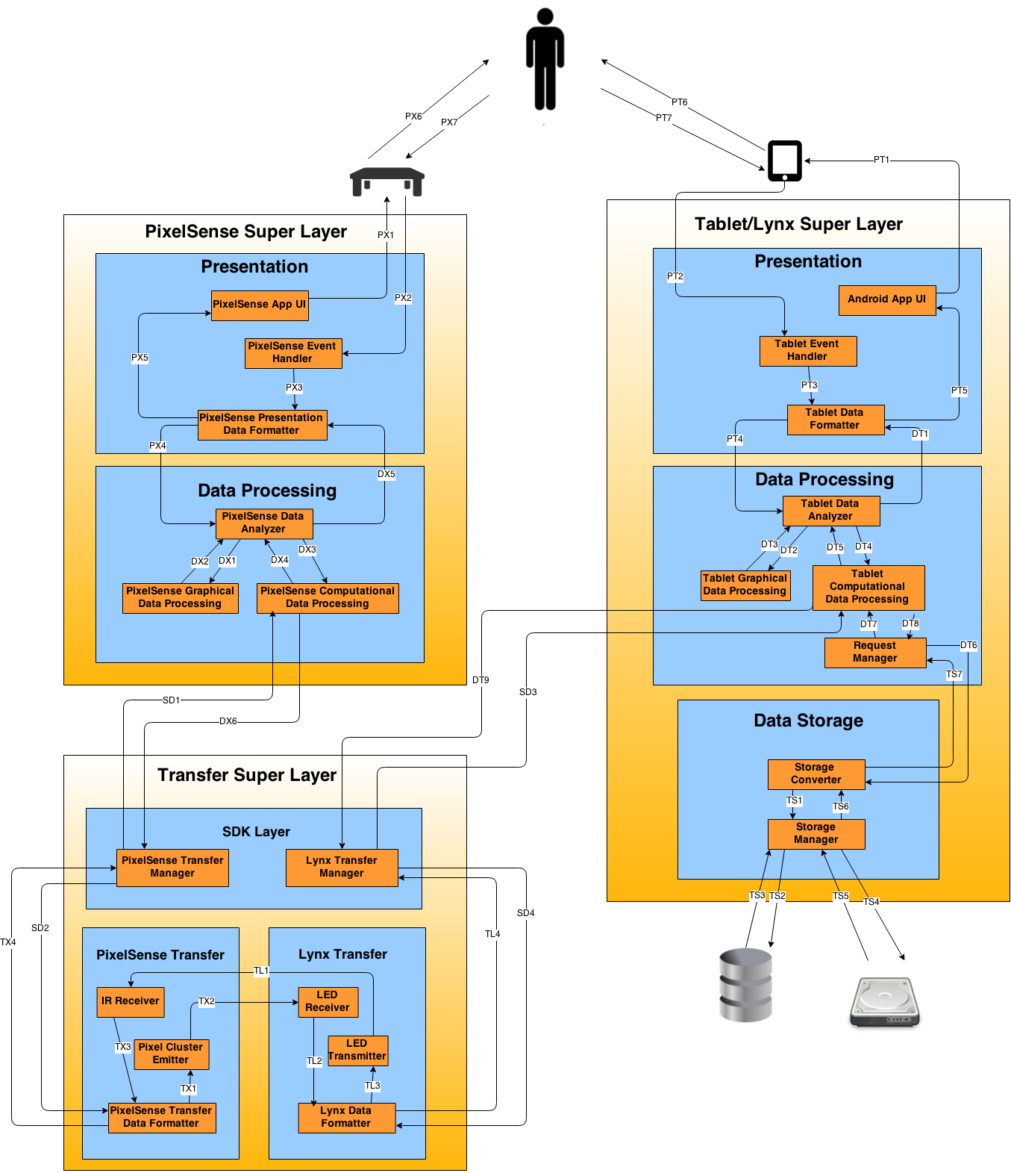

Slide 5
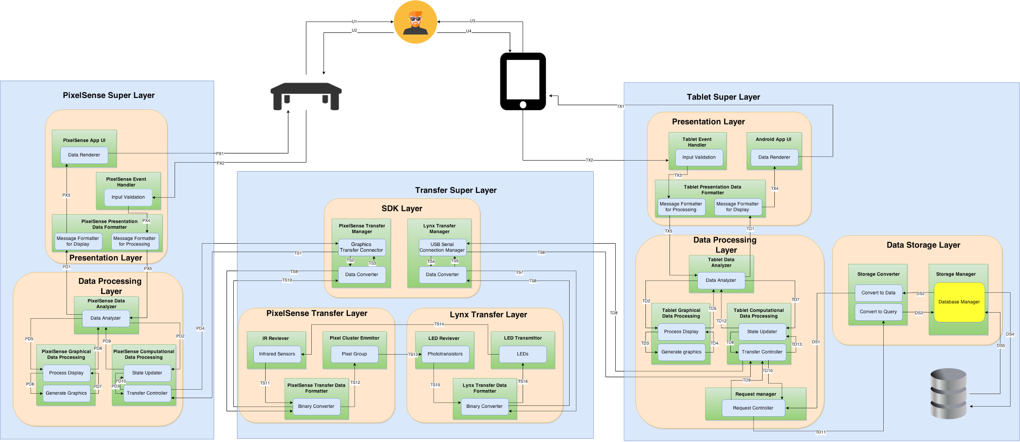

Slide 6
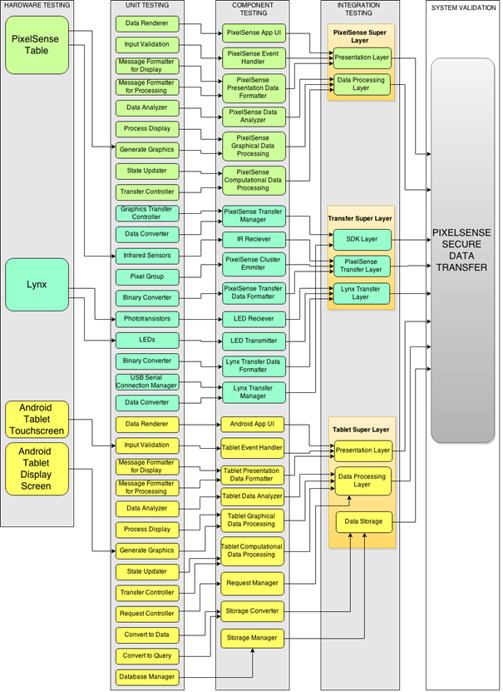

Slide 7
Item Pass/Fail Criteria
Pass Criteria | Fail Criteria
-Item does what it is supposed to | -Item does not do what it is supposed to
-Item performs over the threshold | -Item performs below the threshold
--------------------------------------------------------- | -Hardware failure
-Consistency | -Consistency

Slide 8
Hardware Tests
ID | Functional Unit | Test Method | Priority
H1 | PixelSense Table (Infrared Sensors | Use the lynx device to send an arbitrary string in binary through its IR LEDs and then check if the table outputs the same message. | Very High 5
H2 | PixelSense Table (Table Screen | We will pass a shape (square/rectangle) to the draw command and see if the table will display it | Very High 5
H3 | Lynx (Phototransistors) | We will shine a light on the phototransistor and if it detects a light it should output 3.3v or be “On” | Very High 5

Slide 9
Hardware Tests
ID | Functional Unit | Test Method | Priority
H4 | Lynx (LEDs) | We will tell the microcontroller to duty cycle 1 pin every 100ms and see if the LED turns on and off | Very High 5
H5 | Android Tablet Touchscreen | We will create a button in the application and when the button is a touched a “Toast” notification should appear displaying the touch location | Very High 5
H6 | Android Tablet Display Screen | We will press the power button and wait and see if the tablet will boot into the Android desktop. | Very High 5

Slide 10
Unit Tests
ID | Functional Unit | Test Method | Priority
PTM1 | Graphics Transfer Controller | Emulate input data and record module output for late review input: data transfer requests, returned converted data output: converter function calls, retrieved requested data | Very High 5
PTM2 | Data Converter | Emulate input data and record module output for later review input: data to send, binary arrays output: binary arrays, retrieved data | Very High 5

Slide 11
Unit Tests
ID | Functional Unit | Test Method | Priority
IRR1 | Infrared sensors | Emulate data(sent from Lynx) and record for later review input: raw “touch” data, pixel location informations output: touch meta information, binary data for pixel placement | Very High 5
PCE1 | Pixel Group | Emulate input data and visually verify results input: Binary Pixel information output: Light sequence | Very High 5
PTF1 | Binary Converter | Emulate input and record module output for later review input: binary arrays, touch metadata and pixel location information output: binary arrays, touch metadata and pixel location information | Very High 5

Slide 12
Unit Tests
ID | Functional Unit | Test Method | Priority
LR1 | Phototransistors | Emulate input and record module output for later review* input: light sequence output: binary arrays | Very High 5
LT1 | LEDs | Emulate input and record module output for later review* input: binary sequences (16 bits) output: flashing IR in sequence | Very High 5
LTF1 | Binary Converter | Emulate input and record module output for later review input: binary arrays, touch metadata and pixel location information output: binary arrays, touch metadata and pixel location information | Very High 5

Slide 13
Unit Tests
ID | Functional Unit | Test Method | Priority
LTM1 | USB Serial Connection Manager | Emulate input data and record module output for late review input: data transfer requests, returned converted data output: converter function calls, retrieved requested data | Very High 5
LTM2 | Data Converter | Emulate input data and record module output for later review input: data to send, binary arrays output: binary arrays, retrieved data | Very High 5

Slide 14
Component Tests
ID | Functional Unit | Test Method | Priority
SDK1 | PixelSense Transfer Manager | Emulate data, and run through a chain of modules, recording the results throughout the Layer -input: Request for optic data, -output: Returned optic data result | Very High 5
SDK2 | Lynx Transfer Manager | Emulate data, and run through a chain of modules, recording the results throughout the Layer -input: Request for optic data, -output: returned optic data result | Very High 5

Slide 15
Integration Tests
ID | Functional Unit | Test Method | Priority
TSL1 | SDK Layer | Emulate data, and run through a chain of modules, recording the results throughout the Layer -input: optic data request, -output: optic data transfer results | Very High 5
TSL2 | PixelSense Transfer Layer | Emulate data, and run through a chain of modules, recording the results throughout the Layer -input: data to send optically, -output: light sequences received and translated | Very High 5
TSL3 | Lynx Transfer Layer | Emulate data, and run through a chain of modules, recording the results throughout the Layer -input: data to send optically, -output: light sequences received and translated | Very High 5

Slide 16
System Validation Tests
ID | Functional Unit | Test Method | Priority
V1 | Lynx-PixelSense Secure Transfer System | The ID of the lynx device will be sent to the table where it will be authenticated and an acknowledgment response will be returned. (input: ID, output: Acknowledgement Response) | Very High 5
V2 | Lynx-PixelSense Secure Transfer System | The Lynx device will send a binary sequence of a string through the IR LEDs and the table will display that string on the table display (input: binary data, output: plain text of receipt) | Very High 5
V3 | Lynx-PixelSense Secure Transfer System | The PixelSense table will send a binary sequence of a string through the screen and the tablet will display that string on the tablet display. (input: binary data, output: plain text of receipt) | Very High 5

Slide 17
Risks
Risk | Impact | Severity | Management Plan
Teensy 3.1 not functioning properly | Transfer and receiving tests will be stopped. Could affect the delivery of final product. | High - 5 | Ensure the Teensy 3.1 is functioning properly on arrival and before testing.
PixelSense not functioning properly | Transfer, receiving and application tests will be stopped, may affect the delivery of final product. | High – 5 | Ensure the Samsung SUR40 PixelSense table is functioning properly on arrival and before testing.

Slide 18
Risks
Risk | Impact | Severity | Management Plan
Android Tablet not functioning properly | Transfer, receiving and application tests will be stopped, may affect the delivery of the final product. | High – 5 | Ensure the Android tablet is functioning properly on arrival and before testing.
LED’s and Photo Receiver’s on Lynx not functioning properly | Optical transfer tests will be stopped, unlikely to affect the delivery of final product. | Moderate – 3 | Ensure LED’s and Photo Receiver’s are functioning properly on arrival and before testing. (additional LED’s and Photo Receiver’s have been ordered to decrease severity

Slide 19
Features to be Tested - Customer Requirements
Feature | Test Approach
Send Data Optically | Will be tested along with the Transfer Superlayer Integration test.
Receive Data Optically
Compiled SDK | One team member will impose a guideline for proper documentation of all SDK code. Adherence to these guidelines will establish the necessary pass/fail criteria.

Slide 20
Features to be Tested - Customer Requirements
Feature | Test Approach
Serial Port on Lynx | This feature will be tested in initial Hardware tests.
Error Tolerance | This requirement will be tested along with the PixelSense and Tablet Super Layer integration tests.
Showcase Software
Reliable Connection | This requirement will be tested along with the System Validation tests.
Customizable Light Sequences | This requirement will be met as soon as two different packets (with unique contents) are successfully sent through the Transfer Superlayer.

Slide 21
Features to be Tested - Customer Requirements
Feature | Test Approach
Encoding Data | This requirement will be satisfied with the successful test of the Transfer Super Layer, and the completion of the Lynx prototype. Their success will validate this requirement.
Support 4X4 Array
Lynx Authentication
Lynx - Send & Receive
PixelSense - Send & Receive

Slide 22
Features to be Tested - Customer Requirements
Feature | Test Approach
Lynx Orientation | This requirement will be tested along with the System Validation tests.
Lynx on PixelSense Notification - Tablet | This features will be tested as an authentication function of the SDK definition. The feature is successfully implemented with the Lynx and Table exchanging information about the Lynx’s unique identification number, and noting it for the state on the table.
Lynx on PixelSense Notification - PixelSense
Valid Lynx Device Authentication

Slide 23
Features to be Tested - Packaging Requirements
Feature | Test Approach
Attachable to Tablet | The feature will be tested by constructing a casing that is designed to fit our tablet, and holding the tablet at different orientations. If the lynx remains attached, the test is successful. This test will fail if it is in two discrete pieces, or only connected through wire.
Fully Assembled
Lynx as a Tablet Case

Slide 24
Features to be Tested - Packaging Requirements
Feature | Test Approach
SDK on USB flash Drive | The SDK will be loaded to a flash drive and the test will attempt to recover and use the SDK after loaded. Successful use of the code from USB drive will pass.
PixelSense Casino Software
Android Casino Software
PC Companion Casino Software

Slide 25
Features to be Tested - Performance Requirements
Feature | Test Approach
Minimum Data Transfer Rate | During recording of module output, a time stamp will be supplied to the file. The transfer test will pass if the transfer of data is 200 bits/sec or above relative to these timestamps. The translation test will pass if the conversation of data is less than 1 second relative to these timestamps.
Data Translation
Authentication Time | During recording of module output, a time stamp will be supplied to the file. The test will pass if authentication is less than 5 seconds relative to these timestamps
Software Boot Time | Boot time will be timed by a team member. Success is if boot times consistently finish under 10 seconds.

Slide 26
Features to be Tested - Performance Requirements
Feature | Test Approach
Data Read/Write Time | During recording of module output, a time stamp will be supplied to the file. The test will pass if reading and writing to the Lynx is less than 1 second relative to these timestamps.
Battery Life | During System Validation, one scenario will let the Lynx run for an extended period of time, measuring battery capacity. The test is successful if the battery remains useful through a day’s worth of use.
Overall Connection Time | During recording of module output, a time stamp will be supplied to the file. The test will pass if DB requests are less than 5 seconds relative to these timestamps.

Slide 27
Features to be Tested - Maintenance & Support Requirements
Feature | Test Approach
User Manual | A team member will set a criteria for the structure of the manual. Failing to adhere to this criteria fails the test.
Software Installation | The test passes if the software can be installed on a new device.
Source Code | The test passes if source code for the SDK portion of this system is delivered to the client without compilation in addition to the final product.
Hardware Support | The test fails if the Lynx does not function at the end of development

Slide 28
Features Not to be Tested - Other Requirements
Feature | Reason
System will support Android API 17 and Surface 2.0 | The system is being developed on these platforms already, so testing this would be trivial.
System shall allow an expansion of the array | Initial implementation will include a preconfigured array but the SDK will contain code to transmit in a larger array.
The system shall support multiple devices | System will be tested with one Lynx device, but the code will be able to handle multiple Lynx devices - scalable.

Slide 29
Testing Approaches
Approach | Description
Strategy | A process which will be able to follow data-flows and validate the data on both ends of the system
Unit Testing | Testing every individual module and make sure they are working as intended by receiving the expected output.
Component Testing | The testing of successive modules that are chained together. This will ensure that the connection and integration between each module is working the way it is supposed to.
Integration Testing | This test will be the main connections between each layer and will make sure that the layers integrate with each other.

Slide 30
Testing Approaches
Approach | Description
Regression Testing | This will be testing each module as new additions and modules are added to make sure the already implemented ones do not get broken while integrating the new modules
System Validation Testing | Testing the system as a whole and make sure that it is working the way it was intended for.

Slide 31
Deliverables
Item | Description
System Test Plan | Document that will explain how to test the system’s hardware, software and their integration.
Test Case Specifications | Criteria used: Test ID Description Inputs Expected Output

Slide 32
Deliverables
Item | Description
Test Case Results | Criteria Used:
Test Case ID | Expected Output
Date of Test | Actual Output
Name of Tester | Test Result
Inputs | Tester Comments
Bug ID | Bug Description

Slide 33
Deliverables
Item | Description
Bugs and Defects | Criteria Used:
Bug ID | Test Case ID
Date of Test | Actual Output
Name of Tester | Bug Description
Inputs | Tester Comments
Expected Output

Slide 34
Test Schedule
Work Breakdown Structure | Task | Planned Start | Planned Finish | Resource Name
1.2.5.1 | Hardware Test | 01 March 2015 | 17 April 2015 | Seth Skocelas
1.2.5.2 | Unit Test | 20 March 2015 | 17 April 2015 | Brian Hasty
1.2.5.3 | Component Test | 8 April 2015 | 24 April 2015 | Brian Hasty
1.2.5.4 | Integration Test | 24 April 2015 | 1 May 2015 | Brian Hasty

Slide 35

Questions?

